Slide 1
Order of Operations with Fractions

Slide 2
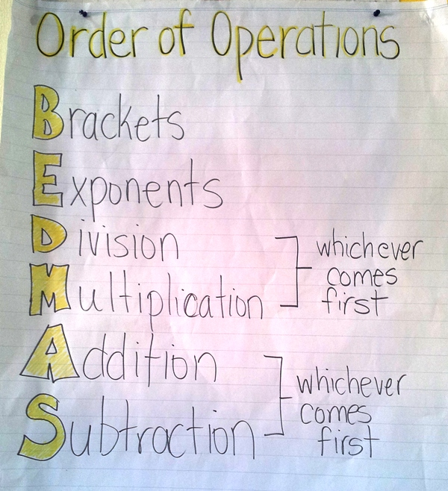
Review

Slide 3
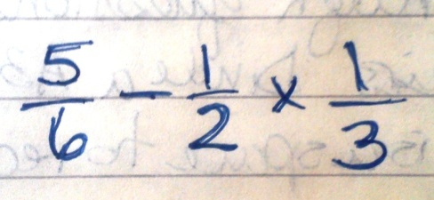
How would you solve ing ?

Slide 4
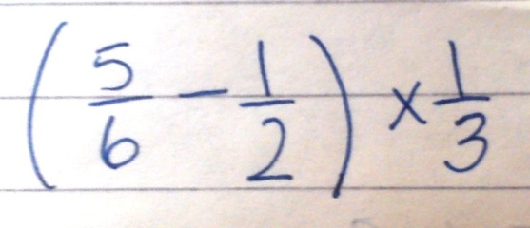
How would you solve ?

Slide 5
How would you solve ?

Slide 6
Practice
Complete the following questions in your notebook:
Textbook page 97-99 #1, 5, 6, 8

