Slide 1
Finding the Root of the Problem and Perfect Square Patterns
Powers and Circles

Slide 2
Lesson 4
Review: What do you notice about a square?
Area of a Square
Perfect Squares
Activity: Discover the Math
Lesson: Finding the Root of the Problem
Practice

Slide 3
What do you notice about a square?
Area of a Square:

Slide 4
Perfect Squares
The area of a square can also be called a “perfect square”
The side lengths in a perfect square are whole numbers (not decimals)
If you know the side length of a square, you can find the Area of that square. You can also find the “Perfect Square”
Example: If a square has side length of 2 cm, the A = 2 x 2 = 2² = 4 cm²

Slide 5
Discover the Math
Complete the “Discover the Math” activity on page 58 in your textbook (questions 1-3)

Slide 6
Perfect Squares
How would you find the side length of a square given it’s area?
Example: If a square has an Area of 25, what is the side length?
We know s x s = A therefore we can write 25 = s x s
A = 25
We also know that s x s = s²
Therefore we can say √s² = √25
s = 5

Slide 7
What if it is not a Perfect Square?
What would the side length be for a square with an Area of 30?
We know s x s = A therefore we can write 30 = s x s
A = 30
We also know that s x s = s²
Therefore we can say √s² = √30
s = 5.5

Slide 8
Key Ideas
Perfect Squares have exact square roots
The square root of a non-perfect square can be estimated by comparing with nearby perfect squares (decimal numbers)
The approximate value of the square root of a non-perfect square can be found by systematic trial or using a calculator.

Slide 9
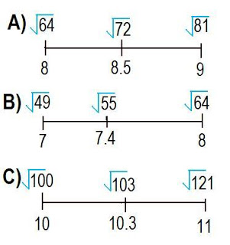
Key Ideas
Examples for Estimating Square Roots:

Slide 10
Homework
Complete notes in your notebook
Go through resources on the Math webpage (class website)

Slide 11
Practice
Make sure your notes are complete – if not you must complete them before moving on to the practice assignment
Textbook:
Pg. 60 #1-4, 6-7, 11-12, 15-16

